Slide 1
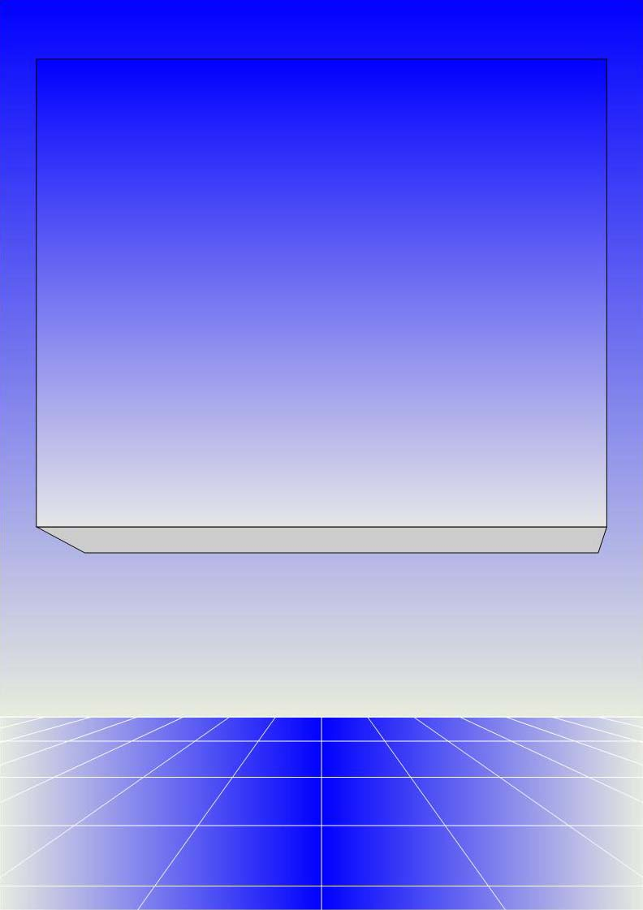
CO2402 - Advanced Programming with C++
Week 20 – Syntax
Gareth Bellaby

Slide 2

Topics
Static local variables
Static data members
Namespaces
Destructors and constructors
Inline functions
True and false

Slide 3
Topic 1
Static local variables

Slide 4
Static local variable
In the context of a normal function, any local variable only lasts the lifetime of the local scope, e.g. a local variable in a function only last the lifetime of the function.
A variable that has the keyword static before it lasts the lifetime of the program.
You need to initialise a static variable (how else could it be used?).
The initialisation only occurs the once even if the function is called multiple times.

Slide 5
Static local variable
void foo( int add )
{
static int keep = 2;
int lost = 2;
keep = keep + add;
lost = lost + add;
cout << keep << " " << lost << endl;
}
foo( 2 ); // output: 4 4
foo( 5 ); // output: 9 7

Slide 6
Topic 2
Static data members

Slide 7
Static data members
The keyword static can be used with the data member of a class.
A static data member is only created once, no matter how many objects of that class are declared.
The one variable is shared by all the objects of that class.
It allows communication and coordination within a class.

Slide 8
Static data members
Static data members must be initialised outside the class definition.
It is the convention that they get initailised in the same file as the class declaration.
You do not re-use the keyword static during initialisation.
An example of use would a set of objects that share a data format, e.g. DirectX vertex declaration.

Slide 9
Syntax of static data member
Declare the data member as part of the class definition.
Initialise it outside the class.
Note the way in the following example that the value of the static data member is set by one object, but accessed by a second object.
The two objects are sharing the data member.

Slide 10
Static data member example
class CTest
{
private:
static int single;
public:
void SetStatic( int data ) { single = data; };
int GetStatic( ) { return single;};
};
int CTest::single = 4;

Slide 11
Static data member example
int main( )
{
CTest* one = new CTest;
CTest* two = new CTest;
cout << one->GetStatic( ) << endl;
one->SetStatic( 7 );
cout << two->GetStatic( ) << endl;
}
The output would be:
4
7

Slide 12
Topic 3
Namespaces

Slide 13
Namespaces
Namespaces support the concept of encapsulation and the scope rules.
The keyword using makes a name available to the local scope.
using namespace std;
This means that all of the "std" namespace is now in scope.
You can be more precise.

Slide 14
Namespaces
The following just makes "cout" available to the local scope:
using std::cout;
It is good practice to limit the openning of scope. It is nice and quick to say "using namespace std". However, by allowing full access to everything in "std" you have left the progarm open to an increased chance of name clashes and ambiguity, e.g. do you know all of the names within the "std" namespace?

Slide 15
Namespaces
It is best practice to use the binary scope resolution operator (::)
#include <iostream>
using std::cout;
using std::endl;
int main()
{
cout << "hello world" << endl;
}

Slide 16
A namespace of your own
You can define your own namespaces.
Use the keyword "namespace".
The code block is delineated by curly brackets.
Note that you don't need a semi-colon at the end of the code block.
The name follows the normal naming convention.
Allow access to own namespace in the same way as to namespaces within the library.

Slide 17
A namespace of your own
namespace myScope
{
void myOwnFunction( int number )
{
cout << number << endl;
}
}
using namespace myScope;
int main()
{
myOwnFunction( 7 );
}

Slide 18
Topic 4
Destructors and Constructors

Slide 19
Destructors and constructors
Base class may contain constructor(s) and destructor(s).
Derived class may also contain constructor(s) and destructor(s).
Useful to know the sequence in which they are called.
There is also a pitfall with polymorphism that you need to be aware of.

Slide 20
Destructors and constructors
class CBase
{
public:
CBase( ) { cout << "Base cons" << endl; };
~CBase( ) { cout << "Base destr" << endl; };
};
class CDerived : public CBase
{
public:
CDerived()
{ cout << "Derived cons" << endl; };
~CDerived( )
{ cout << "Derived destr" << endl; };
};

Slide 21
Sequence of Operations
CDerived* derived = new CDerived;
delete derived;
Base constructor
Derived constructor
Derived destructor
Base destructor

Slide 22
Polymorphism error
The above code is fine.
It works so as the pointer is of the derived class.
However it will not work if you implement polymorphism, i.e. if the pointer is of the base class.
You can have virtual destructors.
Cannot have virtual constructors.

Slide 23
Polymorphism error
CBase* derived = new CDerived;
delete derived;
Base constructor
Derived constructor
Base destructor
So the destructor of the derived class is not being called.
This follows because the pointer is of the base class... but it is not the behaviour we want.

Slide 24
Polymorphism working
class CBase
{
public:
CBase( ) { cout << "Base cons" << endl; };
virtual ~CBase( )
{ cout << "Base destr" << endl; };
};
The answer is to declare the destructor of the base class as being virtual.
This forces a call to the destructor of the derived class and the destructor of the base class.

Slide 25
Polymorphism working
CBase* derived = new CDerived;
delete derived;
Base constructor
Derived constructor
Derived destructor
Base destructor

Slide 26
Topic 5
inline functions

Slide 27
inline functions
A function can be declared using the keyword inline.
Inline functions are not actually called; rather, their code is expanded "in line" at the point of each invocation.
Equivalent functionality to old style C macros.

Slide 28
inline functions
inline int max(int a, int b)
{
return (a > b ? a : b);
}
int main()
{
cout << max(10, 27);
}

Slide 29
inline functions
Expansion is not automatic. It is up to the compiler to decide whether to do it.
Member functions can be declared as inline.
It is common to see constructors declared as inline.
Increase program speed at the expense of size.
A good compromise it to declare short functions as inline.

Slide 30
Topic 6
True and false

Slide 31
bool, true and false
C++ has the keywords bool, true and false.
C++ has automatic conversation between integers and booleans (and vice verse).
Zero (0) is false.
Any other number is true.
Negative numbers are true in the same way that positive numbers are true.

Slide 32
The boolean value of memory
Memory locations can be treated as numbers, e.g. the address held by a pointer.
If a pointer points at 0 then it is false. If it points at a real memory location then it is true.
The compiler guarantees that 0 is never a real memory location.

